Slide 1



Hardware and Software Fundamentals of Intelligent Computing Systems

Slide 2
Lecture 21: In-Depth Analysis of the MLIR Architecture

Slide 3

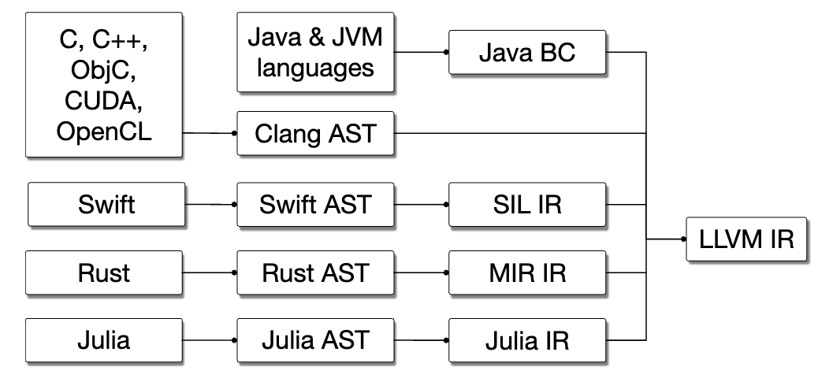
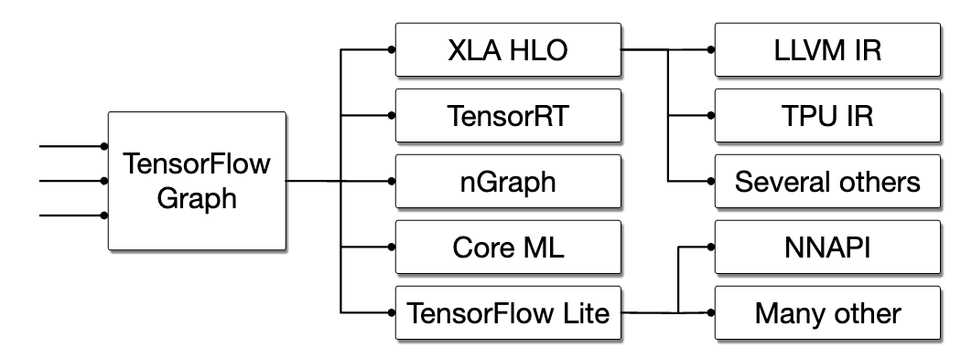
LLVM IR Limitations
General Overview
Design: LLVM IR semantic level is roughly equivalent to“ C with vector operations C language” .
(Multi-Level Intermediate Representation)
Memory Model: Assumes a flattened, linear memory model, primarily operating on scalars, memory pointers, and 1D vector registers.
Deep Learning Computation Graph
is inherently high-dimensional multi-dimensional tensor algebra and deeply nested loops, creating a huge semantic gap between the two.
Forced Flattening: TensorFlow/PyTorch and other high-level frameworks directly lowering to LLVM IR , multi-dimensional tensors are forcefully flattened into 1D memory pointers.
Control Flow Destruction: High-level loop tree structures are destroyed, converted to implicit flat CFG and conditional branch jumps.
https://en.wikipedia.org/wiki/LLVM
Lattner, Chris, et al. "MLIR: A compiler infrastructure for the end of Moore's law." arXiv preprint arXiv:2002.11054 (2020).

Slide 4
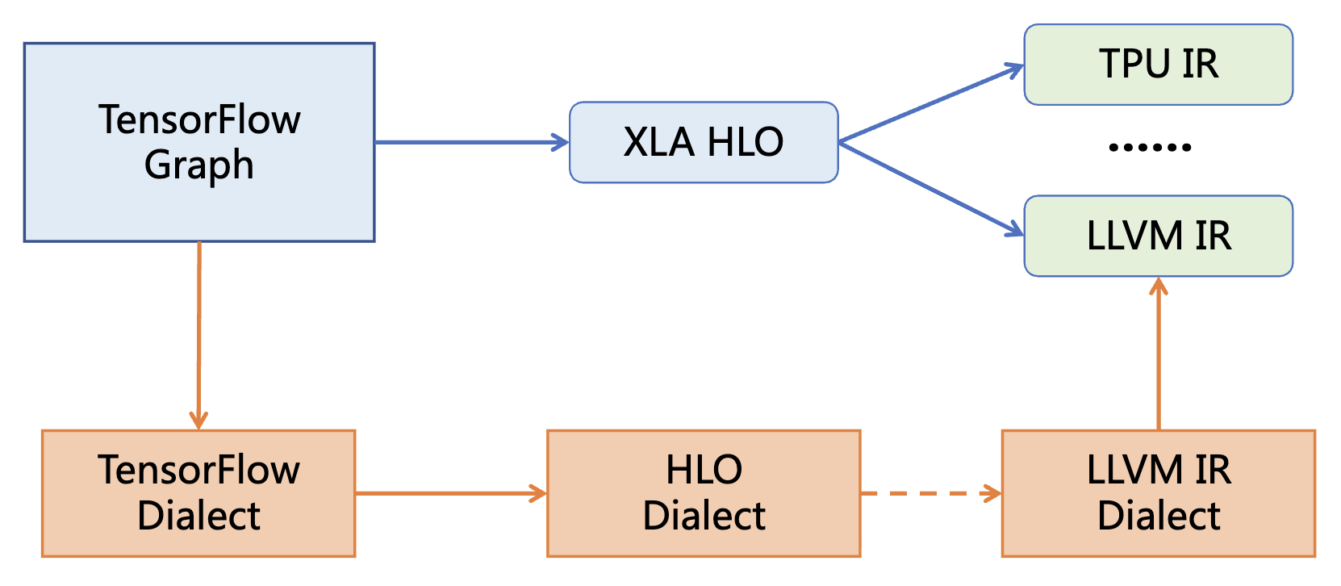
MLIR Architecture
MLIR A reusable, extensible open-source compilation infrastructure framework
Addressing software fragmentation
Support for compilation targeting heterogeneous hardware
Reducing overhead for domain-specific compiler development
Connecting existing various compilers
MLIRWhy Can Solve the Problem
Unified syntax, reusable components
Shared ecosystem, coordinated optimization across levels
Small gaps between levels, easy to implement

Slide 5
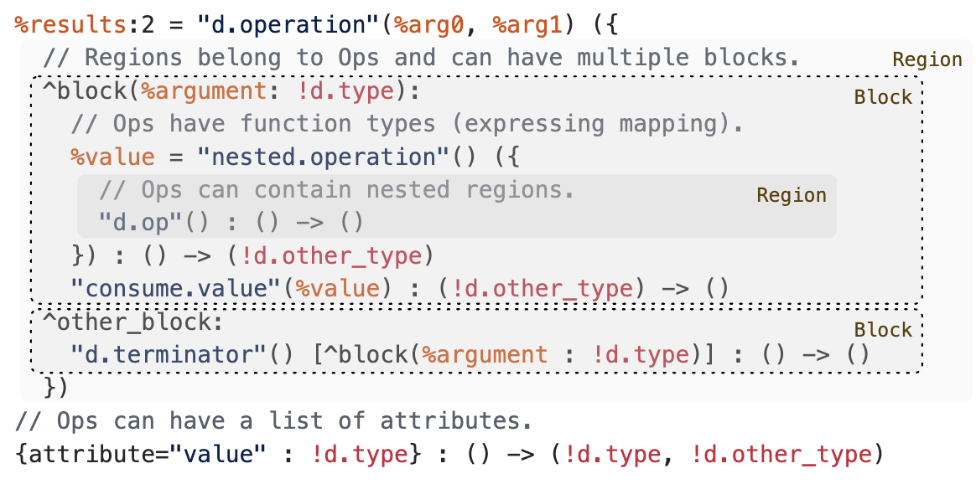
MLIR Components
Module:
Top-level container encapsulating the entire compilation unit, isolating external variable scopes .
Region:
Breaking through flat CFG limitations, preserving loops as“first-class citizens” in nested structures.
Block:
IntroducingBlock Arguments avoiding traditional LLVM high-maintenance PHI nodes
Operation and Attribute:
Highly unified opaque API, along with globally uniqued attribute dictionaries for representing constants.

Slide 6
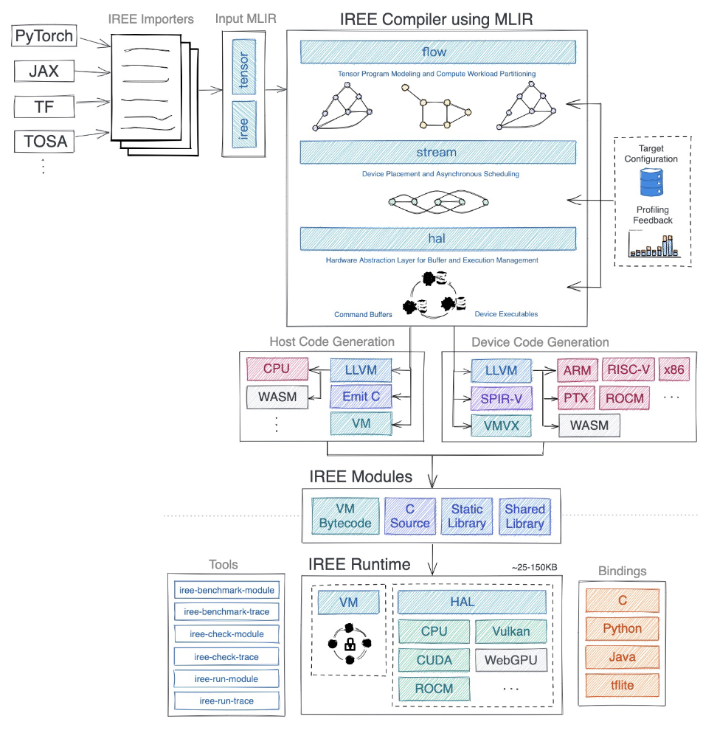
MLIR -Based Deep Learning Framework
From Model Translation to MLIR
Splitting the program into host and deviceGenerating intermediate artifacts (VM FlatBuffers, C file, etc.）
Linking host and device -side code to generate executables/ library and IREE Hardware Abstraction Layer (HAL) linking
IREE Bytecode Virtual Machine (Bytecode VM)
Hardware Abstraction Layer API (HAL API) and various hardware abstractions
General interface and various language
https://hku-systems.github.io/events/iscas2021/1-2-Hongbin%20Zhang%20MLIR.pdf

Slide 7
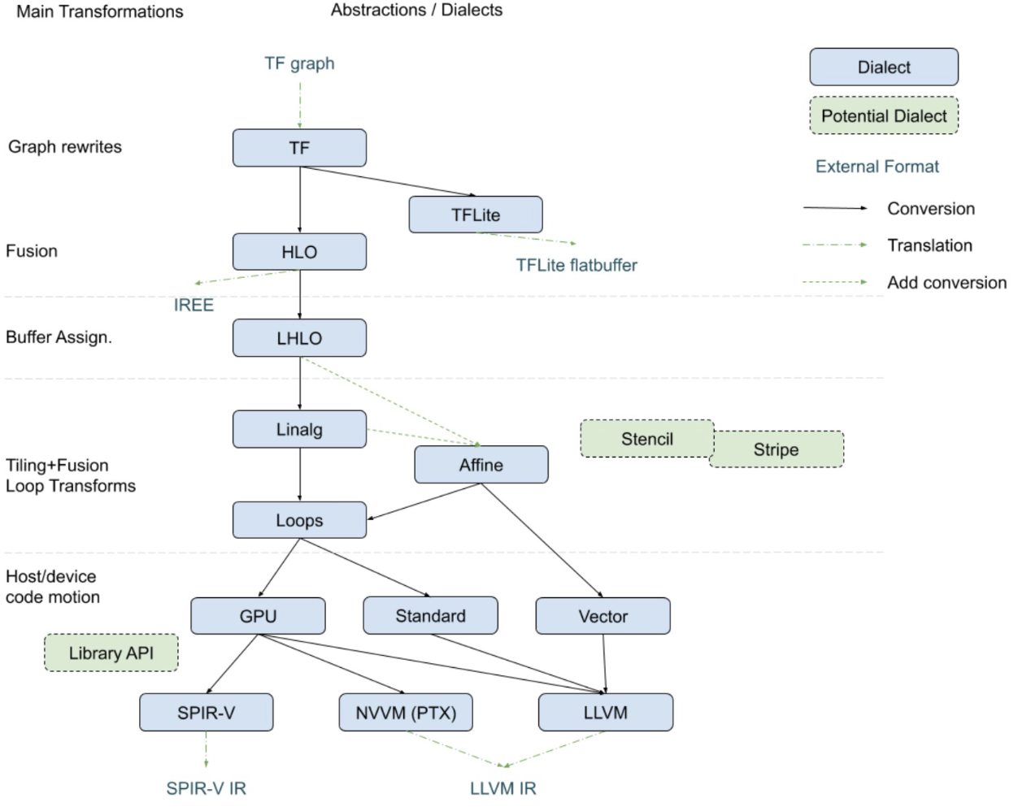
Dialect Dialect System·
Dialect Mechanism Definition:
Dialect is a logical namespace encapsulating operators, types, and attributes customized for specific computational domains .
Within a computation graph, high-level framework dialect (torch), tensor dialect (tensor), loop dialect (affine), and machine code dialect (llvm) can perfectly coexist.
Through inter-dialect Conversion Pass, the compiler can perform“the most appropriate abstraction level” at “the most suitable graph optimization”.
https://mlir.llvm.org/docs/Dialects/Vector/

Slide 8
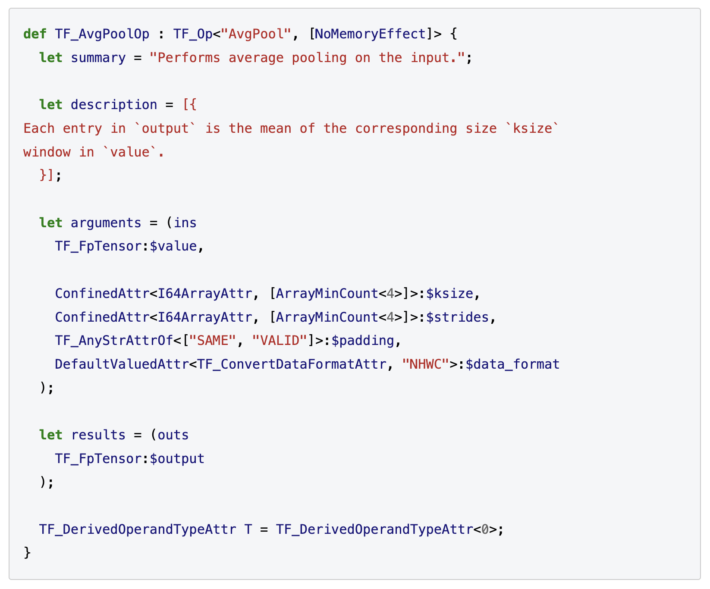
ODS Specification
Declarative Modeling:
Based on LLVM TableGen (.td files) -based declarative operator definition framework.
Single Source of Truth:
Defining operator name, operands, attributes, and return values in one shot through concise descriptive syntax.
Type Constraints:
Directly declaring operator traits in the specification (e.g.,Traits), such as declaring NoMemoryEffect to explicitly inform the compiler that the operator has no memory side effects, allowing aggressive reordering.
https://mlir.llvm.org/docs/DefiningDialects/Operations/

Slide 9
ODS Automated generation
C++ Boilerplate Auto-Generation:
OpDefinitionsGen tool automatically parses and generates standard C++ declaration and implementation code at compile time .
Automatically generating strongly-typed, semantically explicit Getter/Setter
e.g., directly calling .stride() to get stride.
Compile-Time Verification:
Automatically aggregating all constraints and generating a verify() verifier. Before graph optimization begins, automatically intercepting illegal type or tensor shape mismatch cases.

Slide 10
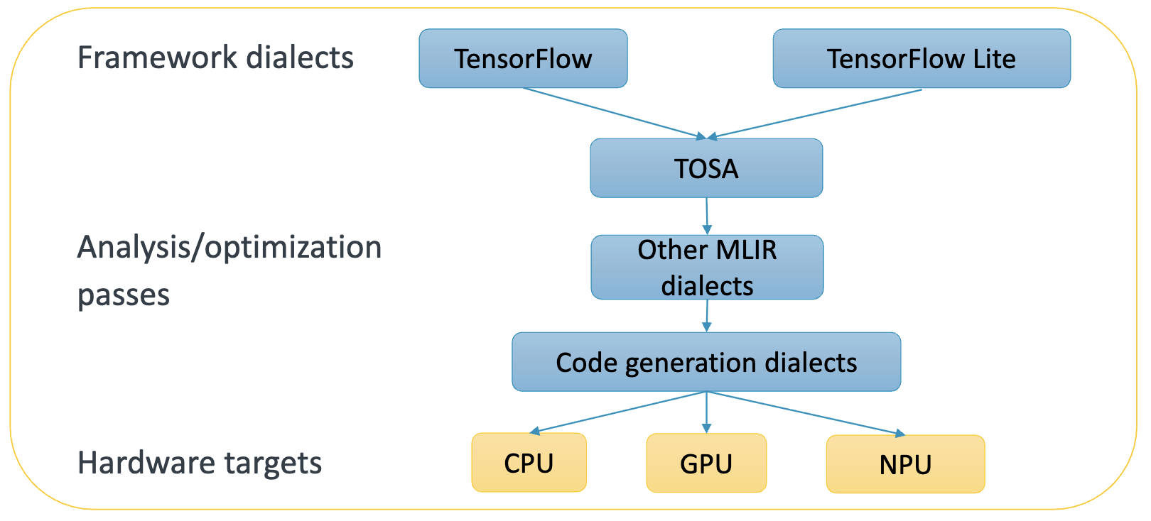
TOSA Dialect
TOSA (Tensor Operator Set Architecture)
Hardware-Independent Tensor Operation Set Specification
Providing a standardized, general set of tensor operations to represent computations in DNNs
Serving as a universal bridge connecting various frontend high-level framework models with backend low-level hardware compilers
https://community.arm.com/cfs-file/__key/communityserver-blogs-components-weblogfiles/00-00-00-37-98/Eric-Kunze-_2D00_-ODIW-2021-_2D00_.pdf

Slide 11
TOSA Design Goals
Hardware Agnosticism (Hardware Agnostic):
TOSA Making no assumptions related to specific hardware architectures (e.g., specific register sizes, cache hierarchies).
Focusing on expressing the mathematical computation semantics of neural networks, not hardware execution details.
Stability and Standardization (Stability & Standardization):
TOSA is backed by a strict specification (Specification)-supported Dialect, aiming to be a stable contract layer. Guaranteeing the legitimacy and consistency of input IR to downstream compilers.
Completeness and Conciseness (Completeness vs. Conciseness):
Containing operators sufficient to express the vast majority of current deep learning models.
Avoiding operator explosion (Operator Explosion): Expressing complex operators through combinations of basic operators, rather than creating a new operator for every minor operation variant.

Slide 12
TOSA in the Compilation Ecosystem
Middle Layer (The Hourglass Neck):
Upward Frontend Connection (Frontend Lowering):
High-level framework models (e.g., TensorFlow Lite, PyTorch Export, ONNX) are converted to high-level Dialect (e.g., tf, torch or mhlo）.
These high-level Dialect can directly or indirectly Lower ( lower) to tosa Dialect.
Downward Backend Connection (Backend Lowering):
tosa is typically lowered to linalg (Linear Algebra) Dialect, then to vector, scf, and finally to llvm Dialect for CPU/GPU execution.
Custom Hardware Path: Hardware vendors can directly extract tosa the computation graph and map it to custom accelerator instruction sets.

Slide 13
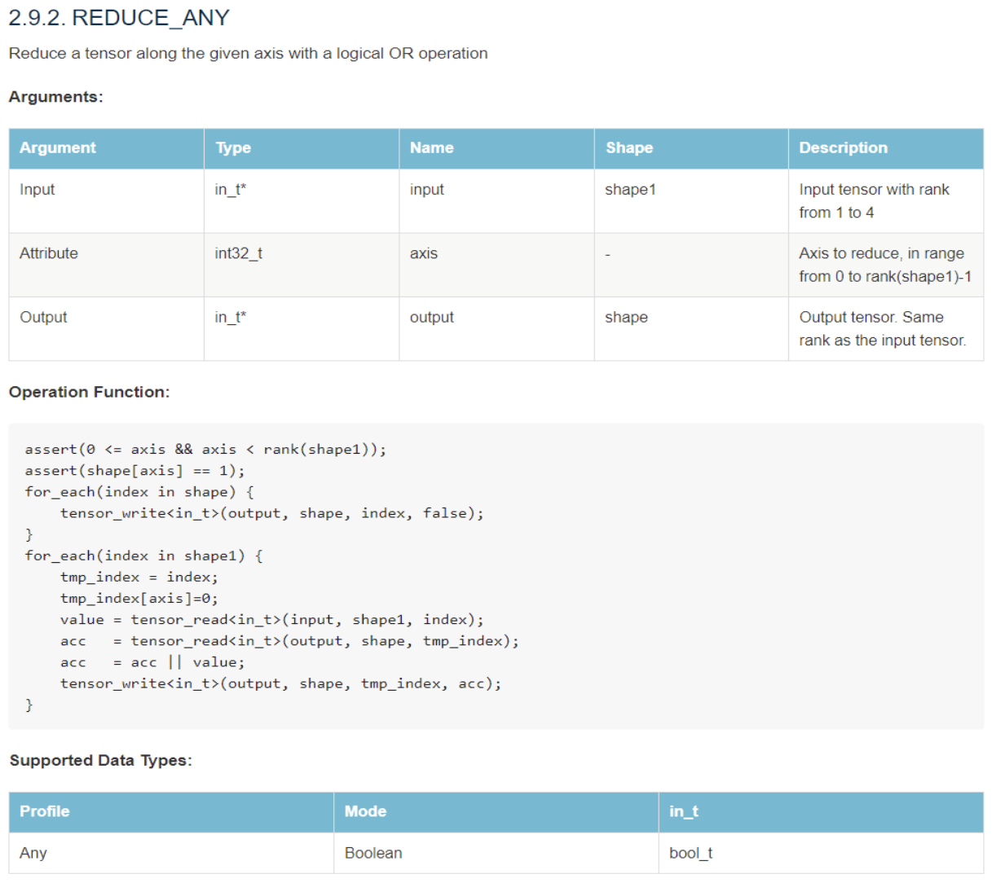
TOSA Dialect Core Operations
Core Operator Categories:
Element-wise Operations (Element-wise): tosa.add, tosa.mul, tosa.exp, tosa.sigmoid etc.
Core Neural Network Computation (Neural Network Ops): tosa.conv2d, tosa.depthwise_conv2d, tosa.matmul, tosa.fully_connected etc.
Tensor Data Manipulation (Data Manipulation): tosa.reshape, tosa.transpose, tosa.slice, tosa.concat etc.
Reduction and Pooling (Reduction & Pooling): tosa.reduce_sum, tosa.max_pool2d etc.

Slide 14
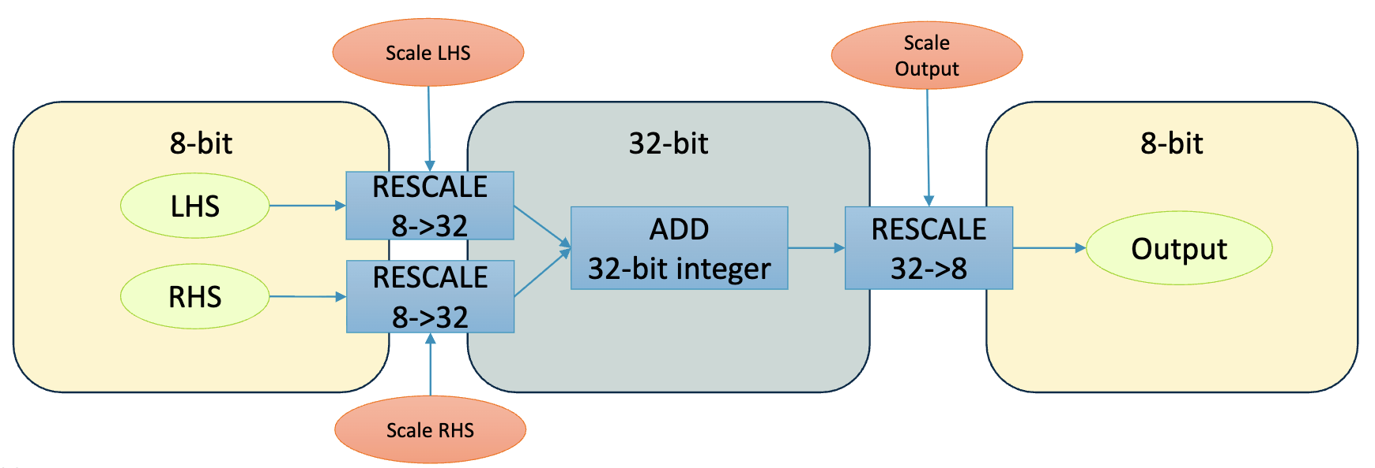
TOSA Dialect Quantization Supporting
First-Class Quantization Support:
TOSA designed quantization as a first-class citizen from the outset (especially targeting edge computing).
Supports floating-point types (FP32, FP16, BF16), natively supports integer//quantization types (INT8, INT16, INT32, INT48）.
Quantization parameters (e.g., scale and zero-point) are directly embedded in operator semantics and attributes, ensuring strict consistency between hardware execution precision and software simulation.
https://community.arm.com/cfs-file/__key/communityserver-blogs-components-weblogfiles/00-00-00-37-98/Eric-Kunze-_2D00_-ODIW-2021-_2D00_.pdf

Slide 15
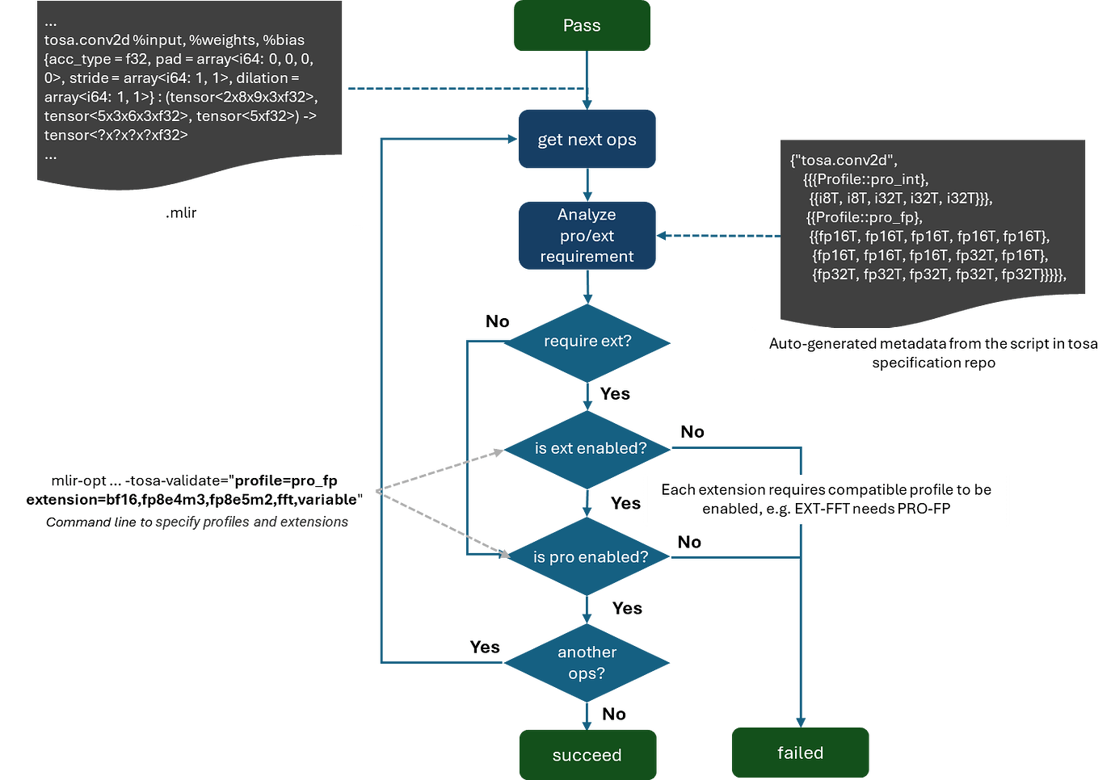
The workflow of TOSA profile-based validation

Slide 16
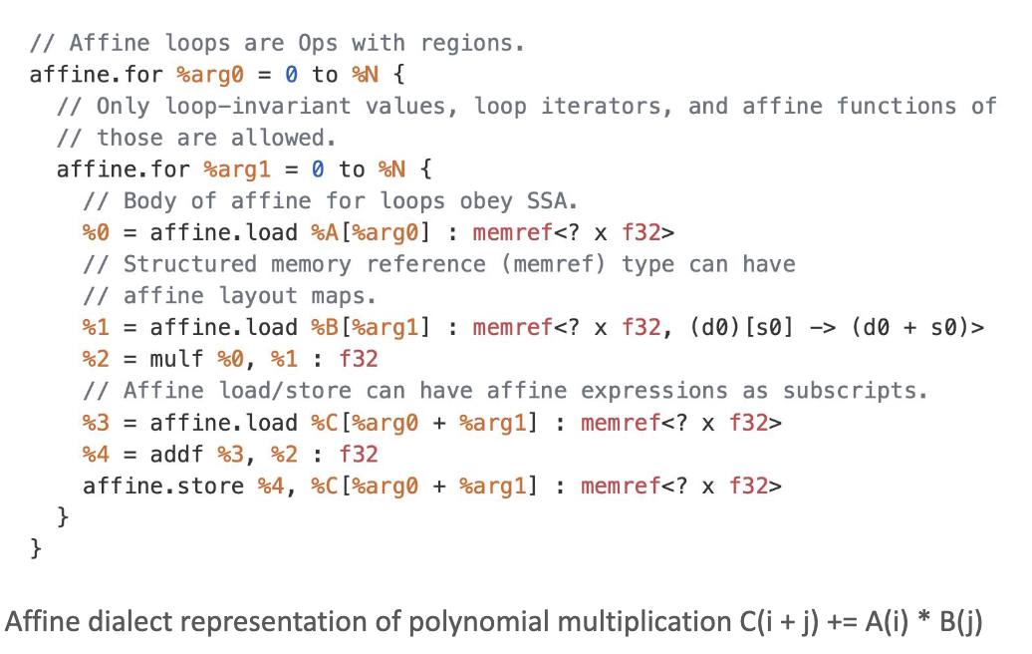
Affine Dialect Overview
Affine Dialect
Specifically designed to express and optimize structured control flow and multi-dimensional memory access IR
Based on the polyhedral model (Polyhedral Model) mathematical foundations, with engineering simplifications
Core Purpose:
Enabling the compiler to perform precise data dependency analysis.
Achieving efficient automatic parallelization, data locality optimization, and complex loop transformations.
https://web.eecs.umich.edu/~mahlke/courses/583w23/lectures/Apr12/Group16_slides.pdf

Slide 17
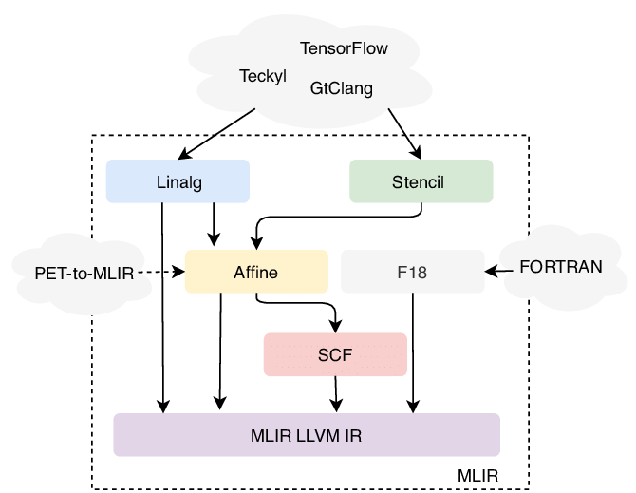
Affine Dialect Overview
Why Is It Called “Affine”？
Loop bounds and memory access indices are strictly restricted to affine functions of loop induction variables and symbols.
Key Concepts:
Dimensions: Typically corresponding to loop induction variables (Induction Variables, e.g., i, j, k）.
Symbols: Parameters that remain constant throughout the loop nest (e.g., dynamic tensor dimensions N, M）.
Affine Map: Defines a mathematical transformation from dimensions and symbols to a set of results (commonly used for array index computation).
Integer Set: An integer space defined using affine constraints, commonly used to represent if condition boundaries.
https://www.researchgate.net/figure/Dialects-available-in-MLIR-and-their-entry-points-PET-to-MLIR-enables-entering-in-the_fig2_347152973

Slide 18
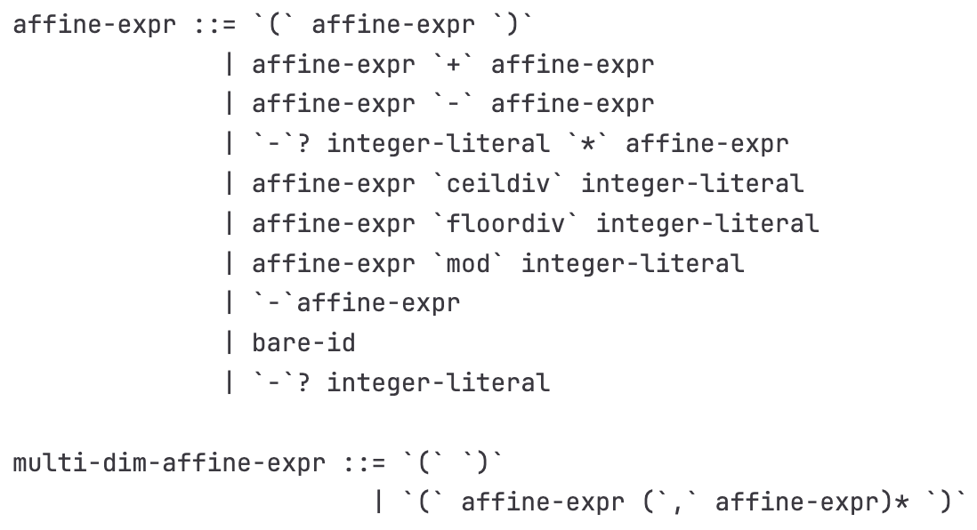
Affine Dialect Key Operators and Syntax
Restricted Control Flow Operations:
affine.for: Defines a loop with known bounds, stride must be a constant.
affine.if: Defines a conditional branch whose condition must be strictly evaluated by an affine integer set (Integer Set).
Restricted Memory Access Operations:
affine.load / affine.store: Reads from memory (MemRef type) or/ writes data.
Core Constraint: Access indices must be valid Affine Map. The compiler knows exactly which memory block each loop iteration accesses.
https://code.ornl.gov/llvm-doe/llvm-project/-/blob/369891b6747e4ad4b5e4e6d06f3f7596f3ee3f02/mlir/docs/Dialects/Affine.md

Slide 19
Affine Dialect Automatic Compilation Optimization
Precise Dependency Analysis:
Since all memory accesses are affine, the compiler can precisely determine data dependencies between instructions/loop iterations at compile time by solving integer linear programming (ILP) problems, precisely determining which instructions/ have data dependencies across loop iterations.
Loop Transformation Strategies:
Loop Tiling: Splitting large loops into smaller blocks, greatly improving CPU/GPU L1/L2 Cache hit rates.
Loop Unrolling : Increasing instruction-level parallelism (ILP), reducing branch overhead.
Loop Fusion and Fission: Merging adjacent loops to reduce memory round-trips, or splitting loops to improve register utilization.
Loop Permutation: Changing the order of nested loops, optimizing stride for sequential memory access .

Slide 20
Affine Dialect in MLIR Position in
Typical Lowering Path:
Upstream Connection: High-order tensor computation Dialect (e.g., Linalg or Tensor) can have certain operations lowered (Lower) to Affine loop nests.
Self-Optimization: in Affine level, performing intensive loop transformations and parallelism analysis (e.g., extracting parallel loops affine.parallel）.
Downstream Output: After optimization, Affine is lowered to generic SCF (Structured Control Flow) or Standard Dialect, and finally converted to LLVM IR to generate machine code.

Slide 21

The Solution: FlagOS, a Unified AI Software Stack

Slide 22








https://space.bilibili.com/3546791834290849
https://github.com/flagos-ai
https://www.zhihu.com/people/95-22-20-18/posts
https://flagos.io/Home

Slide 23

Thanks for your time！

